Slide 1
PROJECT PRESENTATION
Mirko Savić
University of Novi Sad

Slide 2


Slide 3
ADA Consortium
University of Novi Sad (UNS)
University of Belgrade (UB)
University of Nis (UNI)
University of Kragujevac (UNIKG)
Vienna University of Economics and Business (WU)
Graduate school in computer science and mathematics engineering (EISTI)
University of Rome Tor Vergata (UNITOV)
Centre for Research and Technology Hellas (CERTH)
Serbian Association of Managers (SAM)
Associated Partners
+ Friends...
Union of Employers in Vojvodina
Infostud

Slide 4
General goal:
• Capacity building for business analytics studies in Serbia by improving corresponding skills of experts in business analytics.
Specific goals:
• To develop and implement master curriculum in advanced data analytics for business in line with existing European study programs and according to Bologna requirements. The new program will be verified through the accreditation process.
• To organize lifelong learning program in business analytics for professionals in different fields.
START: 15/11/2018 END: 15/11/2021

Slide 5
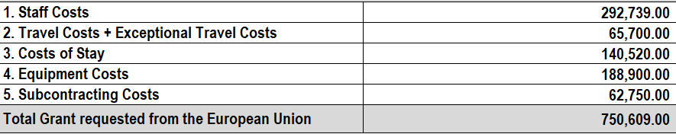
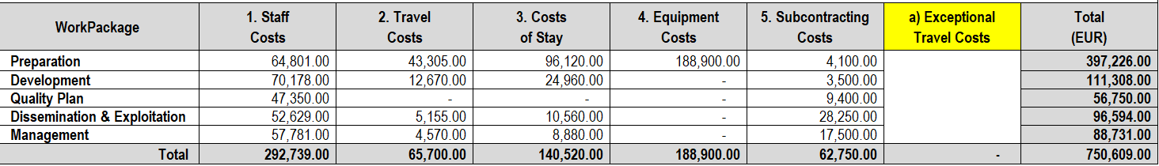

Slide 6

Project activities and methodology
WP1 Development of a new program in Advanced Data Analytics in Business (UNS)
WP2 Preparations for implementation of new master and LLL programs (UB)
WP3 Implementation of the program (UNI)
WP4 Dissemination and exploitation of project results (UNIKG)
WP5 Quality control and monitoring (WU)
WP6 Project Management (UNS)

Slide 7

Main features of master program and LLL courses
Business analytics tools: data visualization tools, business intelligence reporting software, self-service analytics platforms, statistical analysis tools, and big data platforms.
Internationally oriented.
In English.
International teaching staff.
18 months.
10 courses.

Slide 8

The role of Serbian partners
UNS, UB, UNI: Development of master program and LLL courses.
UNIKG: Innovation of existing courses and LLL courses.
SAM: Contact with companies and dissemination activities.

Slide 9

Expectations from EU partners
Advicing
Hosting of study visits (organization of master studies and courses, internship, double degree, foreign students, fees, practical examples of data science, etc.)
Training on different courses in data science
Participation in ADA master
Participation in LLL courses
Quality control of ADA master and LLL courses
Dissemination of project results

Slide 10
Associated partners
Representation of demand side on the labour market
Dissemination of project results

Slide 11
Sirmium (Neoplanta)
?
Alba Graeca (Singidunum)
Vindobona
Thessalonica
Lutetia
Roma
Naissus

Slide 12


Slide 13
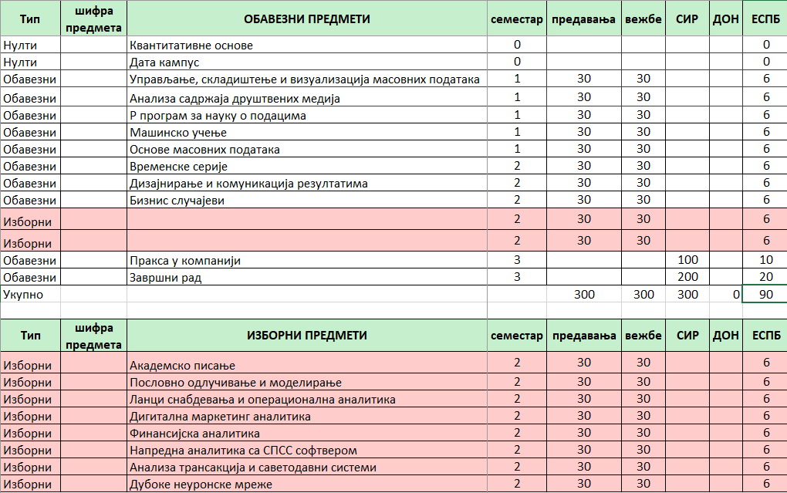

Slide 14


